Slide 1


Using Algorithms to Solve Hard Problems
Matt Norby, Manifest Solutions
https://github.com/mattnorby/Using-Algorithms-to-Solve-Hard-Problems
Notes:
Setup: Log into LC, bring up the nasty test case for Word Search in Notepad

Slide 2




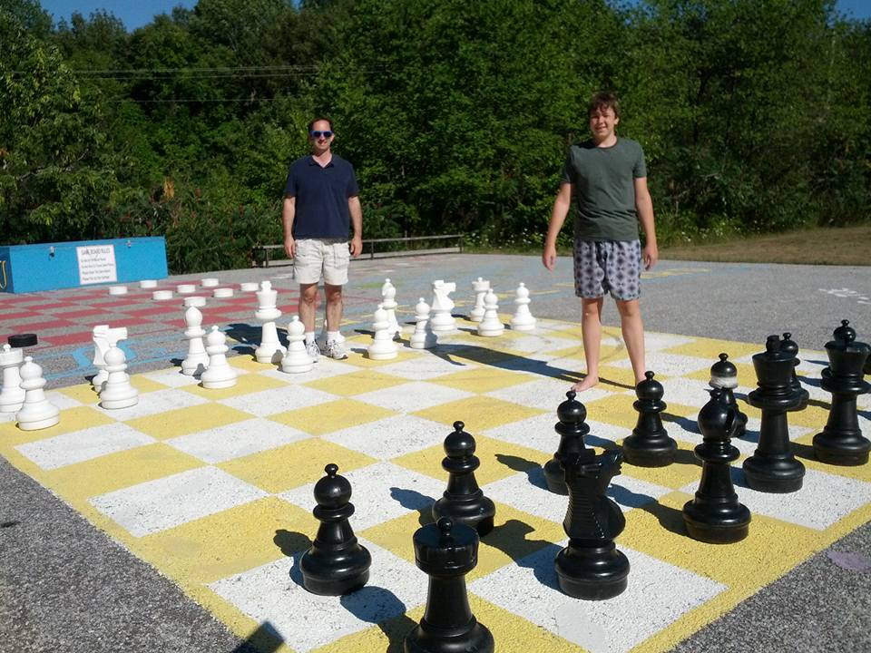

Matt Norby
Email: | mnorby@manifestcorp.com
LinkedIn: | www.linkedin.com/in/matt-norby-6b385212
Twitter: | @matt_norby
Github: | github.com/mattnorby

Slide 3
AGENDA
Why did I start studying algorithms?
What makes a hard problem hard?
Comparing solutions using “big O” notation
Sample problems
How to practice and get better
Notes:
For the harder sample problems, I will sketch solutions without showing a complete implementation.

Slide 4
Flashback to April 2020
Four-week furlough from my client
To stay sharp… and to keep my mind off the news
LeetCode’s daily programming challenges
Notes:
Each challenge has an execution time limit and memory limit. Easy, medium, and hard. I chose Java, there are many other language choices.

Slide 5

AT FIRST

Slide 6

LATER
Notes:
Remember in ST:TNG, when Picard got a “swift kick in the complacency”, when Q introduced him to the Borg for the first time? With the LC hard problems, it seemed like nothing worked. I had hit a wall.

Slide 7
Hard Problems
Difficult to find a viable solution approach
Difficult to break into smaller, solvable pieces
Large scale (e.g. lots of data, very large values)
Learning about algorithms and data structures helped enormously

Slide 8
Why study algorithms?
Learn new approaches to problems
More tools in your toolkit
Benefit from the experience and expertise of other developers
The Ultimate Goal
Think of multiple approaches that might work
Evaluate performance of each approach before writing code

Slide 9
A quick “big O” primer
O
Notes:
In order to evaluate performance, we have to understand “big O” notation.

Slide 10
“Big O” notation
O
A measure of how a program scales, relative to its input
Worst case… within reason
Average case
Runtime and space growth rates
Based on quantity of inputs, size of input, or other factors
Count permutations of an array that satisfy some constraints (quantity)
Find the largest power of 2 that does not exceed a number (size)
The “big O” for a program is its fastest growing part
Drop any coefficients and loose constants
e.g. ½ n² operations and 8n² + 1000 operations are both O(n²)
Notes:
If there are multiple variables, we are interested in the fastest growth rate for each variable.

Slide 11
“Big O” notation: Binary Search
Binary search within a sorted array is O(log n).
Find “7” in this sorted array:
7 < arr[4]
7 > arr[2]
7 = arr[3]
It takes log₂ n steps to find the target value.
2 | 3 | 5 | 7 | 11 | 13 | 17 | 19
2 | 3 | 5 | 7 | 11 | 13 | 17 | 19
2 | 3 | 5 | 7 | 11 | 13 | 17 | 19
Notes:
O(log n) refers to logarithmic growth for any base, but most often we mean base 2. The larger the base, the slower the growth.

Slide 12
“Big O” notation: Array Access
Reading or writing every element of an array is O(n).
public int[] createIndexArray(int n) { int[] arr = new int[n]; for (int i = 0; i < n; i++) arr[i] = i; return arr; }

Slide 13
“Big O” notation: Sorting
Sorting a list of values is generally O(n log n).
Some special cases are as fast as O(n)
Start with an empty output array, and insert a value.
For each of the remaining (n - 1) values:
Binary search to find the correct insertion point. → O(log n)
Insert the value at that position.
→ Repeat binary search, an O(log n) operation, (n – 1) times, to get O(n log n)
Side note: In Java, Arrays.sort() has space complexity O(log n)
Notes:
Special cases: List is nearly sorted already, list consists of sorted sublists

Slide 14
“Big O” notation: Pairwise array operations
Checking every possible combination of values in an array is O(n²).
Suppose we need to find all possible pairwise sums of [2,3,5,7,11].
Reminder: Roughly ½ n² array reads, but we drop the ½ → O(n²)
 | 2 | 3 | 5 | 7 | 11
2 | 4 | 5 | 7 | 9 | 13
3 |  | 6 | 8 | 10 | 14
5 |  |  | 10 | 12 | 16
7 |  |  |  | 14 | 18
11 |  |  |  |  | 22

Slide 15
Comparing “Big O” results
Binary search on a sorted array is O(log n) – “logarithmic”
Reading every element of an array is O(n) – “linear”
Sorting is generally O(n log n)
Finding sums for every pair of elements in an array is O(n²) – “quadratic”
n | O(log n) | O(n) | O(n log n) | O(n²)
100 | 7 | 100 | 700 | 10,000
1,000 | 10 | 1,000 | 10,000 | 1,000,000
10,000 | 14 | 10,000 | 140,000 | 100,000,000
100,000 | 17 | 100,000 | 1,700,000 | 10,000,000,000
1,000,000 | 20 | 1,000,000 | 20,000,000 | 1,000,000,000,000

Slide 16
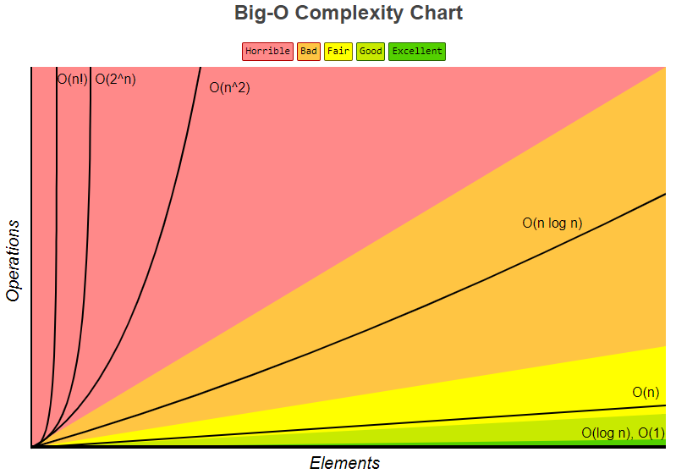
BETTER
Source: bigocheatsheet.com
Notes:
Many problems do not have constant, logarithmic, or even linear solutions

Slide 17
“Big O” notation - Gotchas
Library routines are not necessarily constant time and space
Arrays.sort() appears to be “in place”, but uses O(log n) space
Recursion uses stack space that is transparent to the program
Consider all aspects of input that affect complexity. Examples:
Count of input data elements
Lengths of strings
Minimum / maximum values
Tree depth (if using a tree)
Notes:
Recursion: local variables, including parameter values

Slide 18
Let’s try it!
Notes:
Example problems from LeetCode. We will use Java to solve.

Slide 19
How would you solve…? Triplets
Given an array of ints (32-bit integers).
Find all triplets that add up to zero, and return as a list.
e.g. nums = [-1, 0, 1, 2, -1, 4] → return [-1, 0, 1] and [-1, 2, -1]
class Foo { public List<List<Integer>> getTriplets(int[] nums) { // TODO } }
Notes:
Notice: (1) Array is not sorted, (2) array may contain duplicate values.

Slide 20
Triplets: Three Nested Loops
i
j
k
-7 | -3 | -2 | 1 | 5 | 6
public List<List<Integer>> getTriplets(int[] nums) { List<List<Integer>> answer = new ArrayList<List<Integer>>(); for (int i = 0; i < nums.length - 2; i++) { for (int j = i + 1; j < nums.length - 1; j++) { for (int k = j + 1; k < nums.length; k++) { if (nums[i] + nums[j] + nums[k] == 0) answer.add(List.of(nums[i], nums[j], nums[k])); } } } return answer; }
Three nested loops over nums
Runtime complexity = O(n³)
Space complexity = O(1)
Notes:
Notice, we are being careful to consider any combination of values exactly once.

Slide 21
TRIPLETS: Can we do better?
O(n³) runtime is not great.
Is there any way to avoid checking all possible triplets?
Would it help if the list were sorted?
Notes:
Recursion: local variables, including parameter values

Slide 22
Triplets: Sort and Two Pointer
i
lo
hi
-7 | -3 | -2 | 1 | 5 | 6
Arrays.sort(nums); for (int i = 0; i < nums.length - 2; i++) { int lo = i + 1; int hi = nums.length – 1; while (lo < hi) { if (nums[lo] + nums[hi] < -nums[i]) lo++; else if (nums[lo] + nums[hi] > -nums[i]) hi--; else { answer.add(List.of(nums[i], nums[j], nums[k])); lo++; hi--; } } }
Sort = O(n log n) time, O(log n) space
For and While = O(n²) time
Runtime complexity = O(n²)
Space complexity = O(log n)

Slide 23
Triplets: Summary
Approach | Time complexity | Space complexity
Triple Nested Loop | O(n³) | O(1)
Sort and Two Pointer | O(n²) | O(log n)
The “Sort and Two Pointer” approach should be faster for large n.
It will use a bit more space than the Triple Nested Loop approach.
Notes:
Using “big O” notation, we don’t have to guess which solution will scale better.

Slide 24
How would you solve…? Single Value
Given an array of 32-bit integers.
All of its values appear exactly twice except one, which appears once.
Find and return the value that appears once.
e.g. nums = [2,7,3,5,7,3,2] → return 5
class Foo { public int getSingleValue(int[] nums) { // TODO } }
Notes:
The array is not necessarily sorted.

Slide 25
Single Value: Sort and Scan
public int getSingleValue(int[] nums) { Arrays.sort(nums); for (int i = 0; i < nums.length - 1; i += 2) if (nums[i] != nums[i+1]) return nums[i]; return nums[nums.length – 1]; }
Sort = O(n log n) time, O(log n) space
For loop = O(n)
Runtime complexity = O(n log n)
Space complexity = O(log n)
Note, binary search would be faster than the for loop.
But overall runtime complexity would still be O(n log n).
Notes:
It’s worth keeping in mind that “big O” is not an absolute measure of which approach is faster. It tells us growth rates, and helps us compare for large n.

Slide 26
Single Value: HashSet
public int getSingleValue(int[] nums) { HashSet<Integer> set = new HashSet<Integer>(); for (int i = 0; i < nums.length; i++) if (!set.contains(nums[i]) set.add(nums[i]); else set.remove(nums[i]); return set.iterator().next(); }
Runtime complexity = O(n)… or is it?
Space complexity = O(n)
Need to check HashSet add, remove, contains, iterator!
Notes:
Add, contains, remove, iterator are all library methods, and we need to check them.

Slide 27
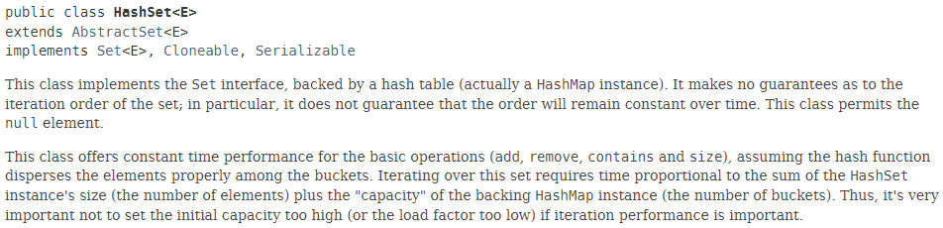
HashSet: RTFM
Within reason, add(), remove() and contains() are O(1).
HashSet capacity grows with size, max size could reach n/2.
Upshot: set.iterator() is O(n), but we only call it once.
Solution runtime complexity is O(n).
Notes:
Add, remove, contains are constant time within reason.

Slide 28
Single Value: bitwise XOR
public int getSingleValue(int[] nums) { int answer = 0; for (int i = 0; i < nums.length; i++) answer ^= nums[i]; return answer; }
For loop = O(n)
Runtime complexity = O(n)
Space complexity = O(1)

Slide 29
Single Value: summary
Approach | Time complexity | Space complexity
Sort and scan | O(n log n) | O(log n)
Sort and binary search | O(n log n) | O(log n)
HashSet | O(n) | O(n)
Bitwise XOR | O(n) | O(1)
Expect the “bitwise XOR” approach to be fastest for large n.

Slide 30
How would you solve…? MEDIAN OF STREAM
Write a class to receive a stream of ints, and find its median.
Values range between -100,000 and 100,000.
There will be up to 50,000 calls to addNum() and findMedian().
Caller may add more numbers, or request the current median, at any time.
class MedianFinder { public MedianFinder() { } public void addNum(int i) { } public double findMedian() { } }
Notes:
Problem 295, Find Median From Data Stream. Median = the middle value (or average of the middle 2 values) in sorted order.

Slide 31
MEDIAN OF STREAM – TREEMAP with Counts
Create a TreeMap<Integer,Integer> as an instance variable
key = number from addNum()
value = counts how many of that number were added
addNum():
“Put” the value in the tree (or increment count)
Increment an overall count
findMedian():
Calculate the position of the median value(s)
Iterate to find the value(s) in the tree
TreeMap
put: O(log n)
Runtime complexity:
addNum: O(log n)
findMedian: O(n)
Overall: O(n²)
Notes:
The iterations in the findMedian method will walk half of the values in the tree, to find the middle value.

Slide 32
MEDIAN OF STREAM – can we do better?
TreeMap works, but findMedian() is slow: O(n) per call
Requires iterating over half of the values
Could we discard values from both ends?
No, addNum() could add enough values to make them relevant
No Java library data structure gives us the median directly.
Maybe we could use two sorted collections… One for each half.
In addNum(), rebalance the lists to equal or nearly equal length.

Slide 33
MEDIAN OF STREAM - PriorityQueue
A PriorityQueue puts values in sorted order as they are added.
Balance between 2 PriorityQueues in asc/desc order.
class MedianFinder { PriorityQueue<Integer> q1, q2; public MedianFinder() { q1 = new PriorityQueue<Integer>(); q2 = new PriorityQueue<Integer>((a,b) -> b - a); }
q1 sorts the larger half in ascending order
q2 sorts the smaller half in descending order
Notes:
Problem 295, Find Median From Data Stream. Median = the middle value (or average of the middle 2 values) in sorted order.

Slide 34
MEDIAN OF STREAM - PriorityQueue
public void addNum(int i) { q1.add(i); q2.add(q1.poll()); if (q1.size() < q2.size()) q1.add(q2.poll()); } public double findMedian() { if (q1.size() > q2.size()) return q1.peek(); return (q2.peek() – q1.peek()) / 2.0; } }
PriorityQueue
add, poll: O(log n)
peek, size: O(1)
Runtime complexity:
addNum: O(log n)
findMedian: O(1)
Overall: O(n log n)
Notes:
q1 = larger half in ascending order, q2 = smaller half in descending order

Slide 35
MEDIAN OF STREAM: summary
Approach | Time complexity | Space complexity
TreeMap | O(n²) | O(n)
PriorityQueue | O(n log n) | O(n)
Expect the PriorityQueue to be faster than the TreeMap.

Slide 36
How would you solve…? Word Search
Given a grid (m x n array, up to 12x12) of uppercase letters, and an array of up to 30,000 uppercase strings of up to 10 characters each.
Return a list of strings that can be found in the grid, moving horizontally or vertically between letters. Words do not need to appear in a straight line.
e.g. grid = , words = [‘CODEMASH’, ’BACON’, ‘BAND’]
class Foo { public List<String> findWords(char[][] grid, String[] words) { /* TODO */ } }
U | C | A | B
D | O | N | H
E | M | A | S

Slide 37
Word Search: Brute force search
public List<String> findWords(char[][] grid, String[] words) { List<String> answers = new ArrayList<String>(); for (int i = 0; i < grid.length; i++) for (int j = 0; j < grid[0].length; j++) { for (int u = 0; u < words.length; u++) { for (int v = 0; v < words[u].length(); v++) { // TODO check 4 directions for matching chars } } } } return answers; }
Runtime complexity = O(m * n * w * 3^{len})
where m, n are grid dimensions,
w is the number of words in the list,
len is the length of the longest word
Space complexity = O(1)
Notes:
3 to the len because after fixing the position of the 1st character, there are 4 choices for the second character and 3 each for the rest of the characters.

Slide 38
Word Search – Can we do better?
Once we find a word, no need to keep checking for it
If any word on the list is not in the grid, we need to visit every cell
Is there a more efficient approach?
Could we organize the word list differently?

Slide 39
Trie structure
B
C
Pronounced “try”
A tree-like structure for sequence searching
Root does not represent a value, other nodes do
Top down: Nodes reference children (not parents)
A good fit for the Word Search problem!
Faster matching at each grid cell
No need to loop over the given word list
Remove words from the trie, once we find them
A
O
C
N
D
O
D
E
N
M
A
S
H
Notes:
Think “retrieval”, not “tree”. Tries have many other uses, e.g. text search, virus pattern matching.

Slide 40
TRIE – SAMPLE CODE
B
C
A
O
C
N
D
O
D
E
N
M
A
S
H
Notes:
Word Search II – problem 212 (show in browser). Don’t forget the nasty test case!

Slide 41
Trie + BACKTRACKING: Complexity
B
C
Time complexity: O(m * n * 3^{len} + w * len)
Construct the trie: O(w * len)
Check matches at each cell: O(m * n * 3^{len})
At each cell, 4 choices for 2nd char, 3 for the rest
Word removals: O(w * len)
…where m, n are grid dimensions w is the length of the word list len is the maximum word length
Space complexity: O(w * len)
A
O
C
N
D
O
D
E
N
M
A
S
H
Notes:
m*n*4*3^len-2 is 4/9 of m*n*3^len. For space complexity, the pointers to next letters are constant space per letter.

Slide 42
Word Search: summary
Approach | Time complexity | Space complexity
Brute force | O(m * n * w * 3^{len}) | O(1)
Trie / backtracking | O(m * n * 3^{len} + w * len) | O(w * len)
Expect the Trie approach to be faster for larger m, n, w, len.
Why? The Trie matches the entire word list at once.
Notes:
Brute force (12x12, 30K words): 255B ops; Trie: 8.5M + 300K. (If running ahead of schedule: Discuss whether it makes sense to make a trie out of the grid instead.)

Slide 43
How would you solve…? Largest Subgraph
Given an array of up to 20,000 distinct integers between 1 and 100,000.
Imagine a graph, where the integers are nodes.
Nodes are connected by an edge if they have a common factor larger than 1.
Find the size of the largest connected subgraph.
e.g. nums = [8, 44, 6, 49, 15] → return 4
class Foo { public int getSubgraphSize(int[] nums) { // TODO } }
49
8
6
44
15
Notes:
Nodes may be part of the same subgraph even if they have no common factors (e.g. 15 and 44)

Slide 44
Subgraph size: Construct Graph and BFS/DFS
Construct the graph in memory, e.g. in a Map<Integer,List<Integer>>
Choose an integer, and find all other “connected” integers
Find all integers that are connected to those integers, and so on
“Breadth-first search”, or BFS
“Depth-first search”, or DFS
Merge lists, keep track of max list size, return max size at the end
Time complexity: O(n² log n) (worst case: not connected at all)
Calculating GCD is O(log n), repeated O(n²) times
Space complexity: O(n²) for the Map (worst case: fully connected)
Notes:
Calculate GCD using Euclid’s algorithm: Repeatedly take remainder when dividing the larger number by the smaller one. Smaller number becomes larger number, remainder becomes the smaller number. Stop when remainder is 0. Answer is the last smaller number.

Slide 45
Subgraph size
Some drawbacks
Constructing the entire graph uses a lot of memory
Calculates GCD for every pair of values
Copies a lot of values around
Can we identify the subgraphs more efficiently?

Slide 46
Union Find algorithm
Start by assuming that nothing is connected: n distinct sets
Create an index array of parent sets: parent[i] = i
As we find connections, “unite” them into a common set (“union”).
Change the parent to the other: parent[j] = i
nums = [8, 44, 6, 49, 15]
nums = [8, 44, 6, 49, 15]
i | 0 | 1 | 2 | 3 | 4
parent[i] | 0 | 1 | 2 | 3 | 4
i | 0 | 1 | 2 | 3 | 4
parent[i] | 0 | 0 | 2 | 3 | 4
i | 0 | 1 | 2 | 3 | 4
parent[i] | 0 | 0 | 1 | 3 | 4
Notes:
Notice, 2 points to 1 and 1 points to 0 as parent, meaning we are forming a tree of parents.

Slide 47
Union Find algorithm
So far, we are building a parent tree, but we only need the top ancestor.
When finding a node’s parent, go all the way to the top ancestor.
Flatten the tree, and point all parents to that ancestor. (“find”)
nums = [8, 44, 6, 49, 15]
nums = [8, 44, 6, 49, 15]
i | 0 | 1 | 2 | 3 | 4
parent[i] | 0 | 0 | 0 | 3 | 4
i | 0 | 1 | 2 | 3 | 4
parent[i] | 0 | 0 | 0 | 3 | 0
The term for this flattening is “path optimization”.

Slide 48
Union Find algorithm
Requires three operations:
Create parents for data elements.
parent[i] = i
“Find” the top-level parent of a given index. Set its parent to the top-level parent.
public int find(int x) { if (x == parent[x]) return x; return parent[x] = find(parent[x]); // path compression }
“Union” two sets by pointing them to a common parent.
public void union(int x, int y) { int topX = find(x); int topY = find(y); if (topX != topY) parent[topX] = topY; }
Notes:
Union and find are O(log n) operations. In the worst case, everything is paired off at the top-level parents’ level, leaving one big tree behind.

Slide 49
Subgraph size: Union find, directly with nums
Create a count array corresponding to each number. (count[i] = 1)
Create a parent index array into nums. (parent[i] = i)
For each value in nums, calculate GCD with every other value.
If GCD > 1:
Find the parent for one of them, and set its parent to the other.
Union the two sets, and transfer the count to the new common parent.
Keep track of the maximum count, and return it at the end.
Time complexity: O(n² log n)
Calculating GCD is O(log n), repeated ½ n² times → O(n² log n)
Union find is O(log n), repeated n times → O(n log n)
Space complexity: O(n) for the count and parent arrays
Notes:
The problem here is that we are still calculating GCD O(n2) times.

Slide 50
Subgraph size: summary
Approach | Time complexity | Space complexity
BFS / DFS | O(n² log n) | O(n²)
Union Find on nums | O(n² log n) | O(n)
That’s better space usage, but time complexity is still a problem.
n can be as large as 20,000. That’s 6 billion operations!
Can we work with a smaller set of numbers?
What about primes?
2 x 3 x 5 x 7 x 11 x 13 < 100K, 2 x 3 x 5 x 7 x 11 x 13 x 17 > 100K
If we know primes up to sqrt(max), any other factor is prime
Notes:
BFS/DFS = 6B ops, UFN = 6B ops, UFP = 500K + 191,840,000 + 300K = 192,640,000. UFP with sqrt(max) = 1264 + 1,300,000 + 300K = 1,601,264. (Pi(316) = 65)

Slide 51
Subgraph size: Union find, prime factors
Calculate an array of primes, up to sqrt(max(nums))
Create count and parent arrays (count[i] = 0, parent[i] = i)
For each value in nums, calculate its distinct prime factors. (up to 6)
Find the parent for the first prime factor, and increment its count by 1.
Union the sets for the other prime factors. Transfer counts to the new parent.
Keep track of the maximum count, and return it at the end.
Time complexity: O(sqrt(max) log log sqrt(max) + n * Pi(sqrt(max)) + n log n)
Calculating primes is O(x log log x) for Sieve of Eratosthenes
Calculating prime factors is O(Pi(sqrt(max))), repeated n times (Pi(x) = # primes less than x)
O(log n) per union find, repeated n times
Space complexity: O(6n) = O(n) for the prime-related arrays
Notes:
Approximately 1.6M operations. Pi(100,000) = 9592. Sqrt(100,000) = 316. Pi(316) = 65.

Slide 52
Subgraph size: summary
Approach | Time complexity | Space complexity
BFS / DFS | O(n² log n) | O(n²)
Union Find on nums | O(n² log n) | O(n)
Union Find on primes | O(sqrt(max) log log sqrt(max) + n Pi(sqrt(max)) + n log n) | O(n)
Expect the “Union Find on primes” approach to be fastest for large n.
Notes:
BFS/DFS = 6.8B ops, UFN = 6.8B ops, UFP = 1264 + 1,300,000 + 300K = 1,601,264. (sqrt(100K) = 316, Pi(316) = 65).

Slide 53
summary
Many problems have multiple solutions
Most developers can think of at least one way to solve a problem
Our first instinct might not lead us to the best approach
We can always learn more approaches
Use “big O” analysis to compare performance for each approach
Growth rates of runtime and space requirements
Ultimate goal: Compare approaches before coding

Slide 54
Putting Algorithms into Practice
LeetCode
Over 2,000 problems to work on, ranked Easy, Medium, Hard
Discussion forum for each problem
Daily challenges, weekly contests
Some alternatives
AlgoExpert.io, Interview Kickstart (interview prep) - $$
Khan Academy
Better to learn before you need to know!
Notes:
Some LC problems require a premium subscription, most are free. You can earn points toward swag (T shirt, laptop sleeve). Top tech companies often ask technical questions that test knowledge of algorithms. AlgoExpert $80/$100 for access to 10 or 150 interview questions, no free trial. Interview Kickstart $600 for trial, $6200 for the full course.

Slide 55
Some final advice
Make observations before writing any code
If you get stuck, use hints
Aim for the most efficient approach, not the fastest execution time
Language-specific performance optimizations are not the point
The “real life” test
When done, analyze your solution, in “big O” terms
Is it possible there is a better approach?
Learn from others’ solutions when you are done
Post and explain your solution in the discussion forum
With “big O”, if possible
Notes:
“Real life” test: Would you code it that way at your job? You write better code when you know it will be reviewed by others.

Slide 56
Questions?
Email: | mnorby@manifestcorp.com
LinkedIn: | www.linkedin.com/in/matt-norby-6b385212
Twitter: | @matt_norby
Github: | github.com/mattnorby

Slide 57
THANK YOU!
Email: | mnorby@manifestcorp.com
LinkedIn: | www.linkedin.com/in/matt-norby-6b385212
Twitter: | @matt_norby
Github: | github.com/mattnorby

